Slide 1
Comprehensive Digital Marketing Project Work

Slide 2


part 1: Brand study, Competitor Analysis & Buyer’s/Audience’s Persona
COMPANY/TOPIC for project: Digit InsurAnce
Research Brand Identity: Study the brand's mission, values, vision, and unique selling propositions (USPs)
Brand Colours : Black , Yellow , white .
Logo :
Mission/Values :Digit's mission is To Make Insurance Simple. We believe true innovation happens when we question the way things are done.
USP:
Digit General Insurance Company offers car, travel, mobile and jewellery insurance. <3 We promise zero form-filling when you call us to make a claim.

Slide 3
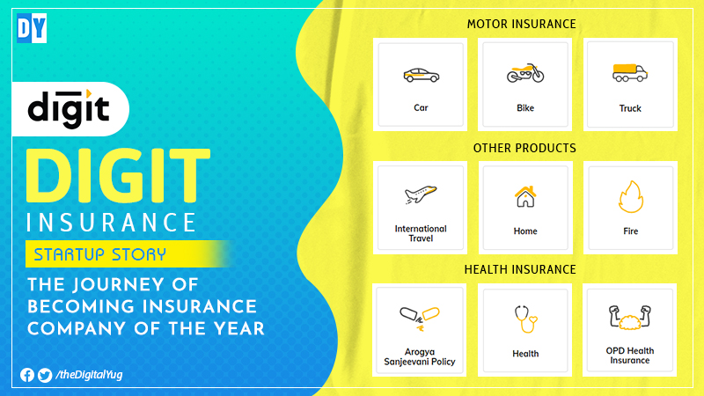

Part 1: Brand study, Competitor Analysis & Buyer’s/Audience’s Persona
COMPANY/TOPIC for project : Digit Insurance
Brand Messaging:
https://thedigitalyug.com/ImageStorage/cl632022121535PM779666.jpg
https://paganresearch.io/images/digit.jpg
Tagline:
Keeping it Simpler

Slide 4
Part 1: Brand study, Competitor Analysis & Buyer’s/Audience’s Persona
Competitor Analysis: Select three competitors operating in the same industry or niche as the chosen brand, examine their USPs and online communication.
Competitor 1:Bajaj Allianz
https://www.bajajallianz.com/
USP :We believe life insurance is about enabling people to live more by providing living benefits.
Online communication:Provided official website URL and chat box
Competitor 2: Policy Bazaar
https://www.policybazaar.com/
USP:Lowest Premium Guranteed with Maximum Benefits.
Online communication : Provided official website URL and chat box
Competitor 3: TATA AIG car insurance
https://www.tataaig.com/
USP : Buy or Renew your Car, Bike & Health Insurance with TATA AIG Premium Policy
Online communication : Provided official website URL and chat box

Slide 5
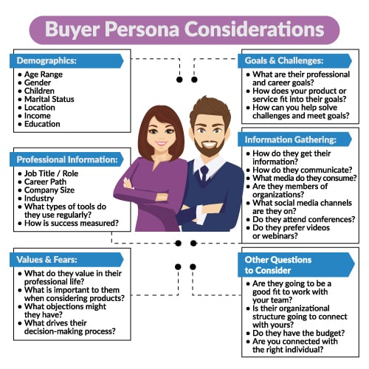
Part 1: Brand study, Competitor Analysis & Buyer’s/Audience’s Persona
Buyer's/Audience's Persona: Clearly define the target audience for the chosen brand. Consider demographics, psychographics, behaviors, and interests.
DIGIT INSURANCE
AGE RANGE: Adult - 18 years Children – 91 days Maximum Entry Age No age limit
GENDER : ALL
CHILDREN : No Age Limit
MATITAL STATUS : Both ( married/unmarried)
LOCATION : Metropolitan Cities
INCOME : Rs 1,247 crore
EDUCATION : B.A , B.COM , BBA
Information Gathering :
How do they get their information?
Customer appication , External database , Internet and social media
Vlues / Fears :
What do they value in their professional life ?
Innovation , Accountability , Adaptability , Empowerment , Social respnsibility

Slide 6
Part 2: SEO & Keyword Research
SEO Audit: Do an SEO audit of the brands website
Keyword Research: Define Research Objectives, Brainstorm Seed Keywords, Utilize Keyword Research Tools (SEMrush or Moz Keyword Explorer),Analyze Competitor Keywords, Long-tail Keyword Exploration (specific, longer phrases) that align with the research objectives and have lower competition but higher conversion potential.
On page Optimization: Meta Tag optimization & content optimization
Reflect on the process of conducting keyword research and the SEO recommendations provided.
Document the challenges faced during the research and analysis phase, as well as the key insights gained from the keyword research process.

Slide 7
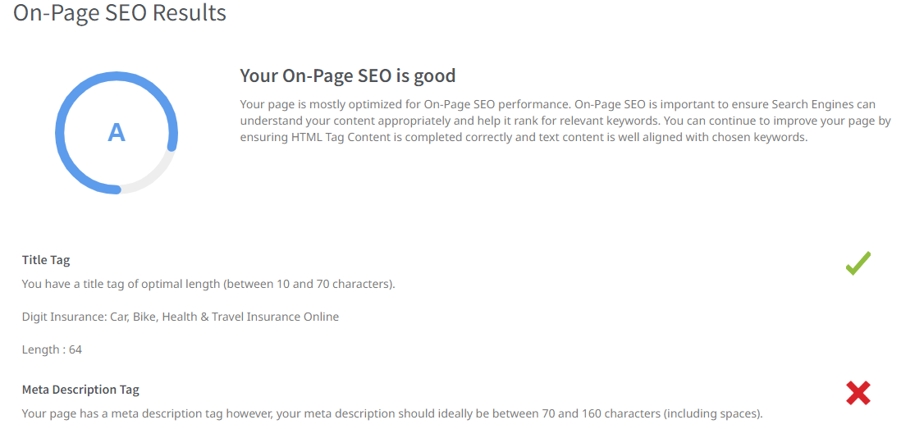

Slide 8
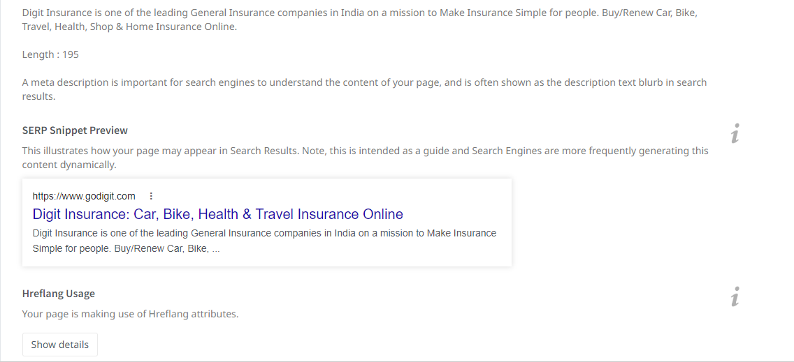

Slide 9
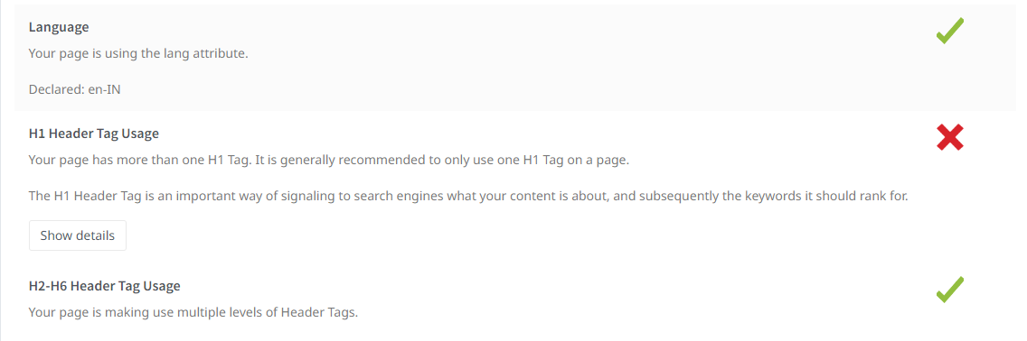

Slide 10
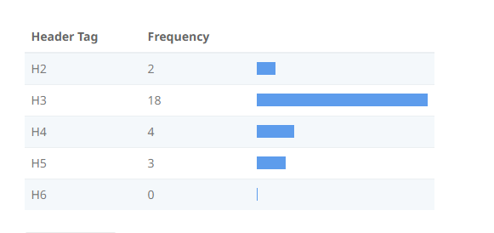

Slide 11
Keyword | Avg. monthly searches | Conpetition
motor insurance policy | 5000 | Medium
best mediclaim policy | 5000 | Medium
medical insurance policy | 5000 | Medium
META TITLE
Explore policies like motor insurance,best mediclaim,medical insurance policies 79
META DESCRIPTION
Apply new featured policies like motor insurance policy , best mediclaim policy , medical insurance policy 106
Keyword Avg. monthly searches Competition
reliance travel insurance 5000 Medium
medical health insurance 5000 Medium
digit health insurance 5000 Medium
META TITLE
Explore insurances like reliance travel, medical health, digit health insurances 80
META DESCRIPTION
Check eligibility apply insurances like reliance travel , medical health , digit health insurances 98

Slide 12
Keyword Avg. monthly searches Conpetition
insurance plans 5000 Medium
star insurance plans 500 Medium
travel insurance plans 500 Medium
META TITLE
Find the best plans like insurance, star insurance, travel insurance plans 74
META DESCRIPTION
Check and apply plans like insurance , star insurance , travel insurance plans 78
Keyword Avg. monthly searches Conpetition
flight insurance coverage 50 Medium
motor coverage 50 Low
international health coverage 50 High
META TITLE
Find coverages like flight insurance, motor, international health coverages 75
MATA DESCRIPTION
Apply new featured coverages like flight insurance, motor, international health coverage 89

Slide 13
Keyword Avg. monthly searches Conpetition
star health mediclaim 5000 Medium
hdfc mediclaim 5000 Medium
maternity mediclaim 500 Medium
META TITLE
Find mediclaims like star health, hdfc, maternity mediclaims 61
META DESCRIPTION
Apply new featured mediclaims like star health mediclaim, hdfc mediclaim, maternity mediclaim 93

Slide 14
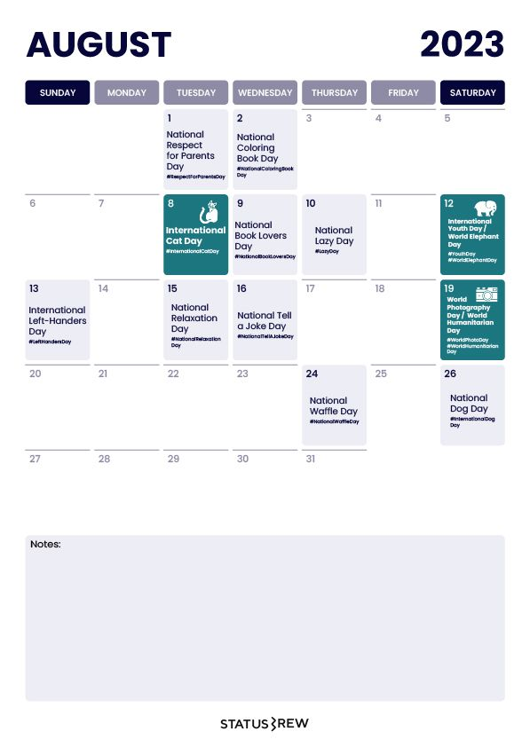
Part 3: Content Ideas and Marketing Strategies
Content Idea Generation & Strategy: Create a content calendar for the remaining month of July by brainstorming content themes, exploring various formats like blog posts, videos, infographics, podcasts, and interactive quizzes, and scheduling publication dates mainly on Facebook & Instagram.
And include the strategy, aim and the idea behind these posts and story
Content Calendar Example (Try creating a table for the month of July)

Slide 15


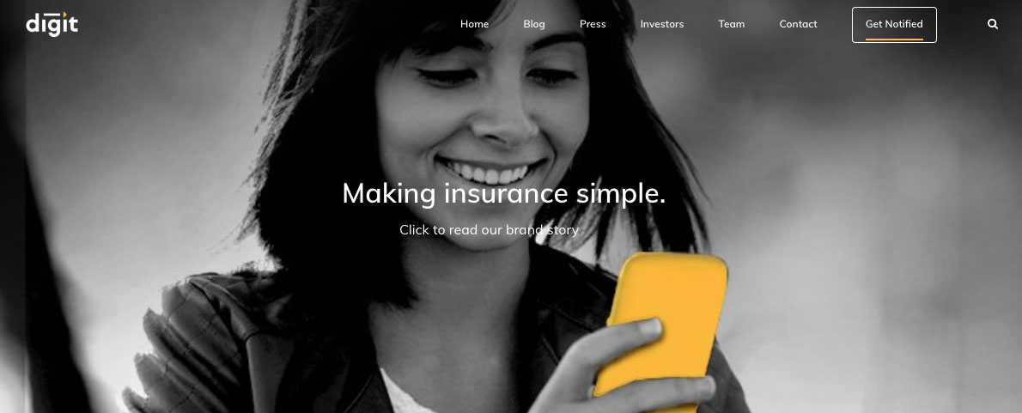
Part 3: Content Ideas and Marketing Strategies
Date : 30th july
To provide simple and innovative insurance solutions to individuals and businesses.To make insurance more
accessible, understandable, and convenient for customers.
Date : 02-08-2023
To create Awareness on Digit insurance policy
Information about Digit insurance policy.
Date : 03-08-2023
Awareness about Insurance frauds & scams.
To raise Awareness about Insurance frauds & scams.

Slide 16
Part 3: Content Ideas and Marketing Strategies
Reflect on the content ideas and marketing strategies process, discussing the challenges encountered and lessons learned.
Creating content ideas and devising effective marketing strategies is a dynamic process that involves continuous learning and adaptation. Throughout this journey, several challenges and valuable lessons
can be encountered.
1.Understanding the Audience: One of the primary challenges is comprehending the target audience's
preferences, needs, and pain points.
2. Generating Unique Ideas: Coming up with fresh and innovative content ideas can be difficult, especially in saturated markets.
3. Consistency and Quality: Maintaining a consistent flow of high-quality content can be demanding. Setting up an editorial calendar and adhering to a content creation schedule helps in maintaining quality and meeting
deadlines.
4. Content Promotion: Even the best content may not gain traction without proper promotion. Crafting effective marketing strategies to reach the target audience across various channels is crucial for success. 5.Collaboration: ollaborating with influencers or other brands can amplify the reach of content and
strengthen marketing efforts. The content ideas and marketing strategies process is an iterative and learning-oriented journey

Slide 17
Part 4: Content Creation and Curation (Post creations, Designs/Video Editing, Ad Campaigns over Social Media and Email Ideation and Creation)
Post Creation:
Select Content Categories: Identify three different content formats relevant to the chosen topic or industry. Research and Brainstorm: Research trending topics, industry news, or audience interests within each category. Brainstorm ideas for social media posts that align with each category. Do note that 1 content format has to be video and additionally 3 stories/status are to be created.
Format 1: Blog article
Format 2 : Video
Format 3 : Creative

Slide 18
Part 4: Content Creation and Curation (Post creations, Designs/Video Editing, Ad Campaigns over Social Media and Email Ideation and Creation)
Format 1 : Blog Article
Aim : To provide simple and innovative insurance solutions to individuals and businesses.
Date : 30-07-2023
Idea : To make insurance more accessible, understandable, and convenient for customers
Topic :
Step 1: Understanding the Needs of Individuals and Businesses
Digit Insurance begins by thoroughly understanding the insurance needs of individuals and businesses. This involves conducting market research, analyzing customer feedback, and studying industry trends.
Step 2: Simplifying Insurance Concepts and Processes
Once the needs are identified, Digit Insurance focuses on simplifying insurance concepts and processes. They break down complex insurance jargon into easy-to-understand language, ensuring that individuals and businesses can make informed decisions about their coverage options.

Slide 19
Step 3: Leveraging Technology and Data Analytics
Digit Insurance leverages technology and data analytics to enhance their insurance solutions. They use advanced algorithms and data analysis techniques to assess risks, determine appropriate coverage levels, and offer personalized insurance options.
Step 4: Offering Innovative Products and Services
Digit Insurance aims to provide innovative insurance products and services that meet the evolving needs of individuals and businesses.
Step 5: Streamlining the Insurance Buying Process
Digit Insurance focuses on streamlining the insurance buying process. They offer a user-friendly online platform where individuals and businesses can easily compare different insurance policies, customize coverage, and purchase their desired plans.
Step 6: Ensuring a Seamless Claims Experience
In the event of a claim, Digit Insurance aims to provide a seamless and hassle-free experience for individuals and businesses.
Step 7: Building Trust and Long-Term Relationships
Digit Insurance places a strong emphasis on building trust and long-term relationships with their customers.

Slide 20

Part 4: Content Creation and Curation (Post creations, Designs/Video Editing, Ad Campaigns over Social Media and Email Ideation and Creation)
Format 2 : Video
Aim : To create Awareness on Digit insurance policy
Date : 2-08-2023
Idea : Information about Digit insurance policy
Topic : This video visualised the Importance of Digit Insurance

Slide 21

Part 4: Content Creation and Curation (Post creations, Designs/Video Editing, Ad Campaigns over Social Media and Email Ideation and Creation)
Format 3 : Creative
Aim : Awareness about Insurance frauds & scams
Date : 03-08-2023
Idea : To raise Awareness about Insurance frauds & scams
Topic : meme

Slide 22
Part 4: Content Creation and Curation (Post creations, Designs/Video Editing, Ad Campaigns over Social Media and Email Ideation and Creation)
Instagram Story
Utilize the Stories feature on Instagram for three consecutive days. Share behind-the-scenes glimpses, polls, quizzes, or sneak peeks etc to encourage audience participation. Once uploaded use the story highlight feature on Instagram and save the 3 story with an appropriate name for each.
Note:
Once done monitor the performance of the posts and Stories using the insight tool and analyze the engagement metrics (likes, comments, shares, impressions, etc.). Based on the analysis, mention the strategies and areas for improvement.

Slide 23
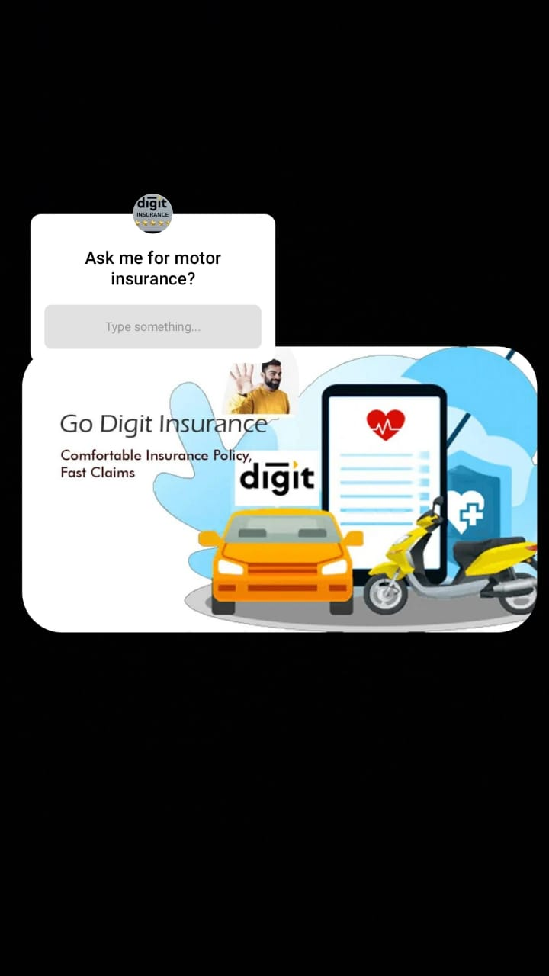
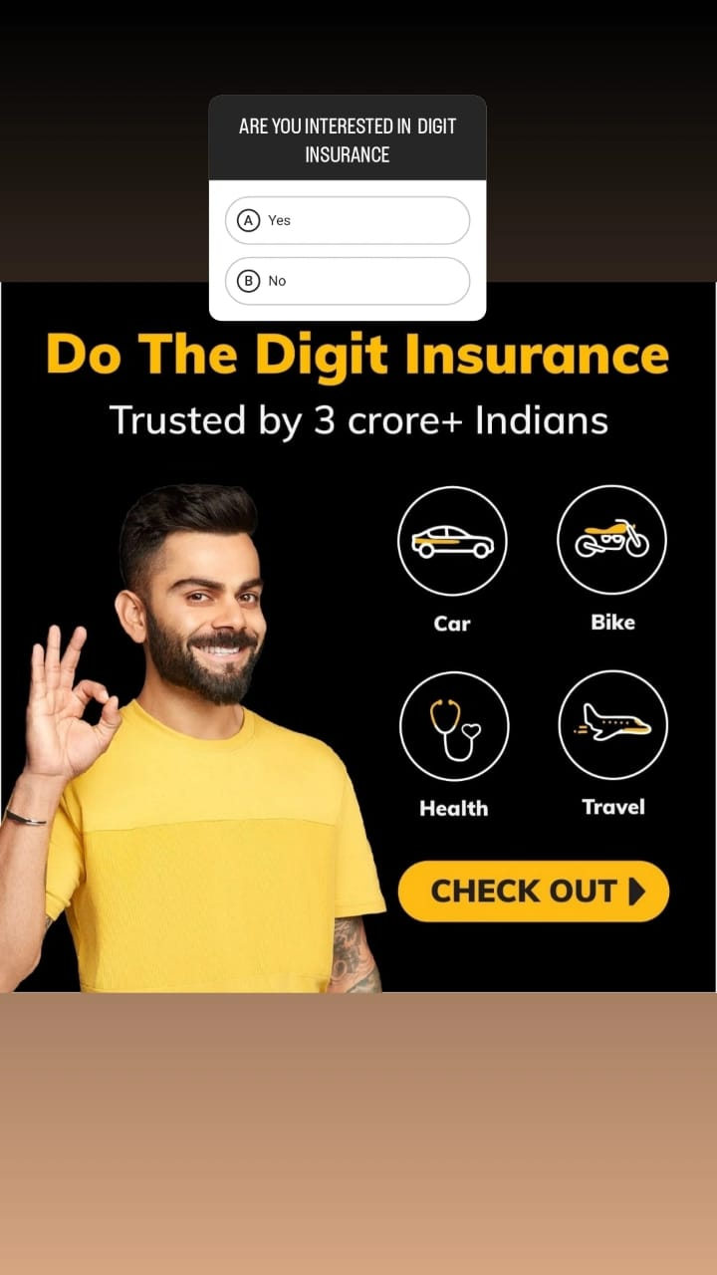
Part 4: Content Creation and Curation (Post creations, Designs/Video Editing, Ad Campaigns over Social Media and Email Ideation and Creation)
Instagram Story

Slide 24
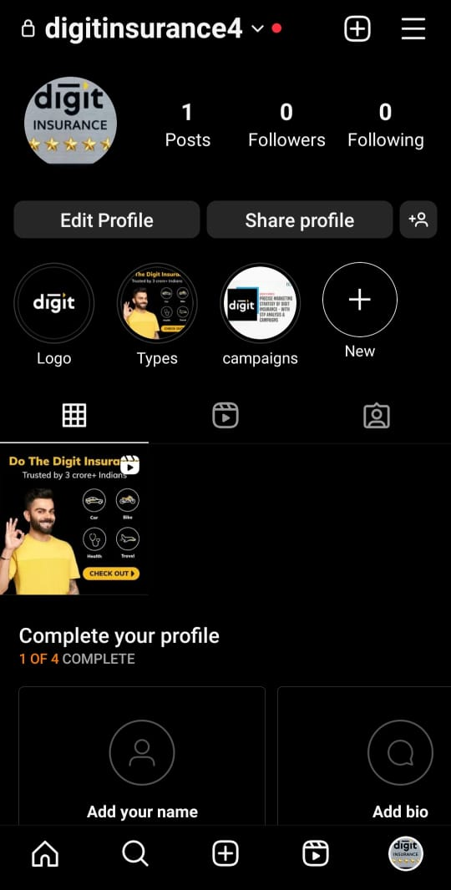
Instagram Story

Slide 25
Part 4: Content Creation and Curation (Post creations, Designs/Video Editing, Ad Campaigns over Social Media and Email Ideation and Creation)
Designs/Video Editing

Slide 26
Part 4: Content Creation and Curation (Post creations, Designs/Video Editing, Ad Campaigns over Social Media and Email Ideation and Creation)
Social Media Ad Campaigns
Ad Campaigns over Social Media:
Come up with 3 ad campaigns each covering one of the mentioned goals: brand awareness, driving website traffic, or generating leads

Slide 27
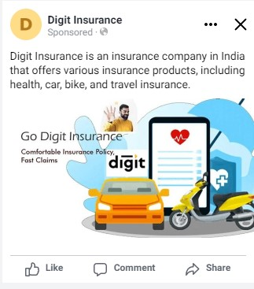
Brand Awareness :
Targeting : Location : India , all genders, Age , Interest : Motor Insurance,
Health Insurance.

Slide 28
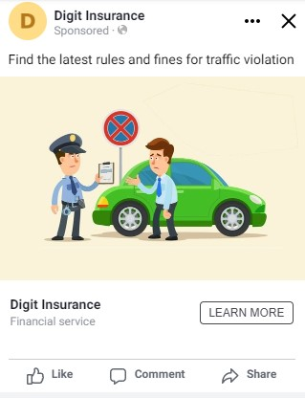
Driving Website traffic :
Targeting :Location : India , all genders, Age , Interest : Motor Insurance,
Health Insurance.

Slide 29
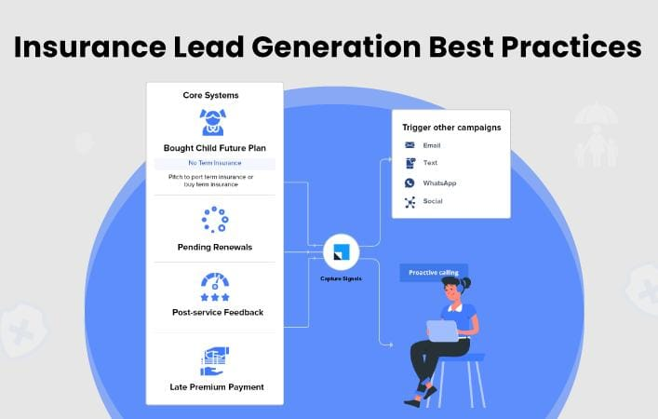
Generating Leads :
Targeting :Location : India , all genders, Age , Interest : Motor Insurance,
Health Insurance.

Slide 30
Part 4: Content Creation and Curation (Post creations, Designs/Video Editing, Ad Campaigns over Social Media and Email Ideation and Creation)
For every campaign clearly define:
Advertising Goals: increasing brand awareness, driving website traffic, or generating leads.
Audience Targeting: Define the target audience for the ad campaigns based on demographics, interests, and behavior.
Ad Creation: Create visually appealing ad creatives, compelling ad copy and relevant call-to-action.

Slide 31
Part 4: Content Creation and Curation (Post creations, Designs/Video Editing, Ad Campaigns over Social Media and Email Ideation and Creation)
Email Ad Campaigns
Ad Campaigns for email marketing:
Come up with 2 email ad campaigns with the mentioned goals: brand awareness & generating leads

Slide 32
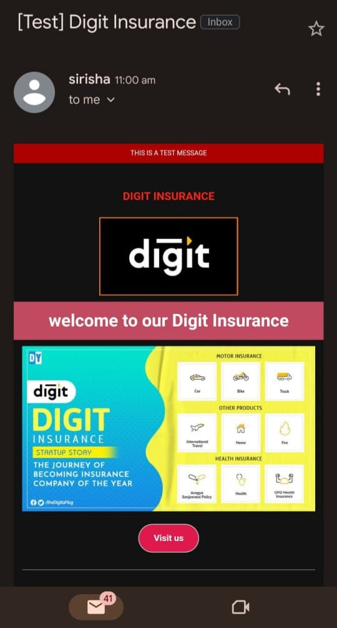
Email Ad Campaign 1 - Brand Awareness
(insert emailer image)

Slide 33
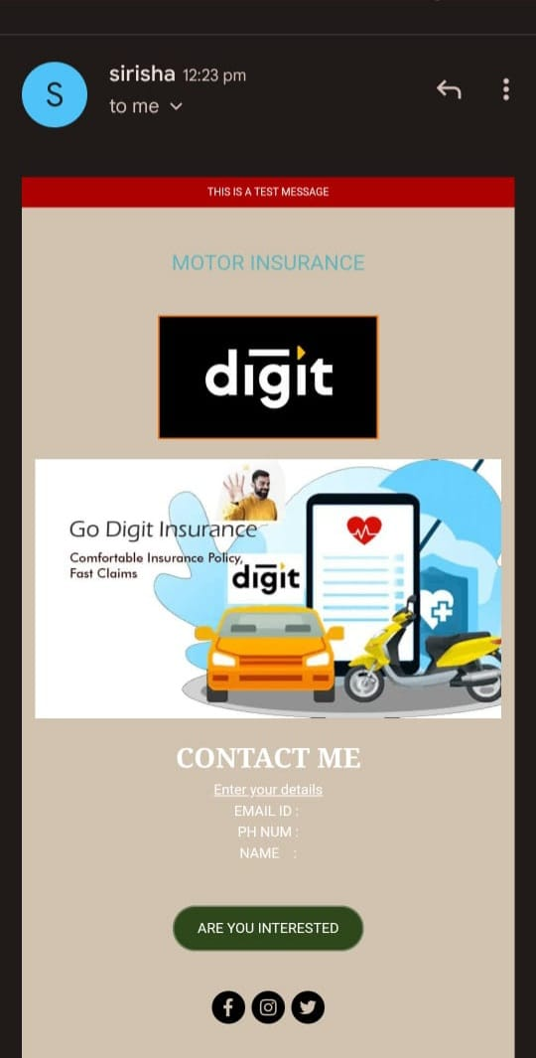
Email Ad Campaign 2 - Lead Generation
(insert emailer image)

Slide 34
Part 4: Content Creation and Curation (Post creations, Designs/Video Editing, Ad Campaigns over Social Media and Email Ideation and Creation)
Reflect on the content creation and curation process, discussing the challenges faced and lessons learned.
1.Know our Audience: Understanding the target audience's interests, pain points, and preferences is fundamental in creating relevant and engaging content.
2.Visual Appeal: Eye-catching visuals, well-designed graphics, and professionally edited videos can significantly
enhance the impact of content and ad campaigns.
3. Consistency is Key: Maintaining a consistent tone, style, and frequency of content across platforms helps reinforce
brand identity and improves audience recall.
4. A/B Testing: Regularly conducting A/B + tests for ad campaigns and email subject lines allows for data-driven optimization and better results.
5. Engage with the Audience: Responding to comments, messages, and feedback from the audience fosters a sense
of community and builds trust.
6. Long-Term Approach: Content creation and marketing are not one-time endeavors. A long-term, strategic approach is necessary to build brand awareness and achieve sustainable growth.
In conclusion, content creation and curation, along with thoughtful design, video editing, and well- executed ad campaigns, play a pivotal role in a successful marketing strategy. By understanding the challenges and incorporating the lessons learned, businesses can create compelling content that resonates with their target. audience and drives results

